Slide 1

James Edward
Padgett

Slide 2
California Penal Code § 1096
“Proof beyond a reasonable doubt is proof that leaves you with an abiding conviction that a fact is true. The evidence need not eliminate all possible doubt because everything in life is open to some possible or imaginary doubt.”

Slide 3
California Evidence Code § 411
"Except where additional evidence is required by statute, the direct evidence of one witness who is entitled to full credit is sufficient for proof of any fact."

Slide 4
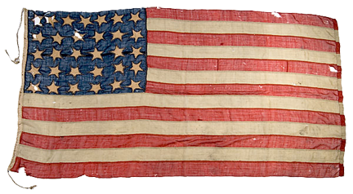
America in the 1850s

Slide 5
America in the 1850s
Slavery was the issue facing the nation
Post Mexican-American war
Great Compromise of 1850
  Five Legislative Acts were part of the compromise
    Texas gave up its claim to New Mexico territory
    California was added as a Free State, becomes 31st State
    New Mexico & Utah could choose slavery (popular sovereignty)
    Passage of Fugitive Slave Act
    Slave trade banned in Washington D.C.

Slide 6
America in the 1850s
1852
Henry Clay died: first to receive the honor of lying in state in the U.S. Capitol rotunda
Daniel Webster died
Harriet Beecher Stowe penned the masterpiece of American slavery, “Uncle Tom's Cabin.” Stowe wrote this work of anti-slavery in response to the Fugitive Slave Act.
James Edward Padgett was born in Washington D.C.

Slide 7
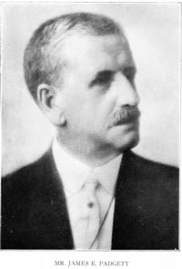
James Edward Padgett
Born: August 25, 1852
Passed: March 17, 1923

Slide 8
James Edward Padgett
Lived entire life in
Washington D.C.
Was a young, boy during the Civil War:
1861 to 1865
Padgett was 8 years, 7 months old when the war started, and he was 12 years, 8 months when the war ended.

Slide 9
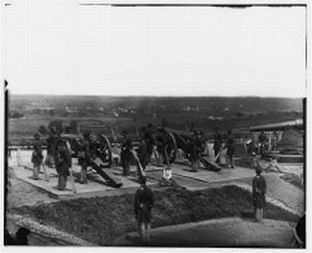
Washington D.C.
By the end of the Civil War, Padgett’s home town was the most heavily fortified city in North America, perhaps even in the world.

Slide 10
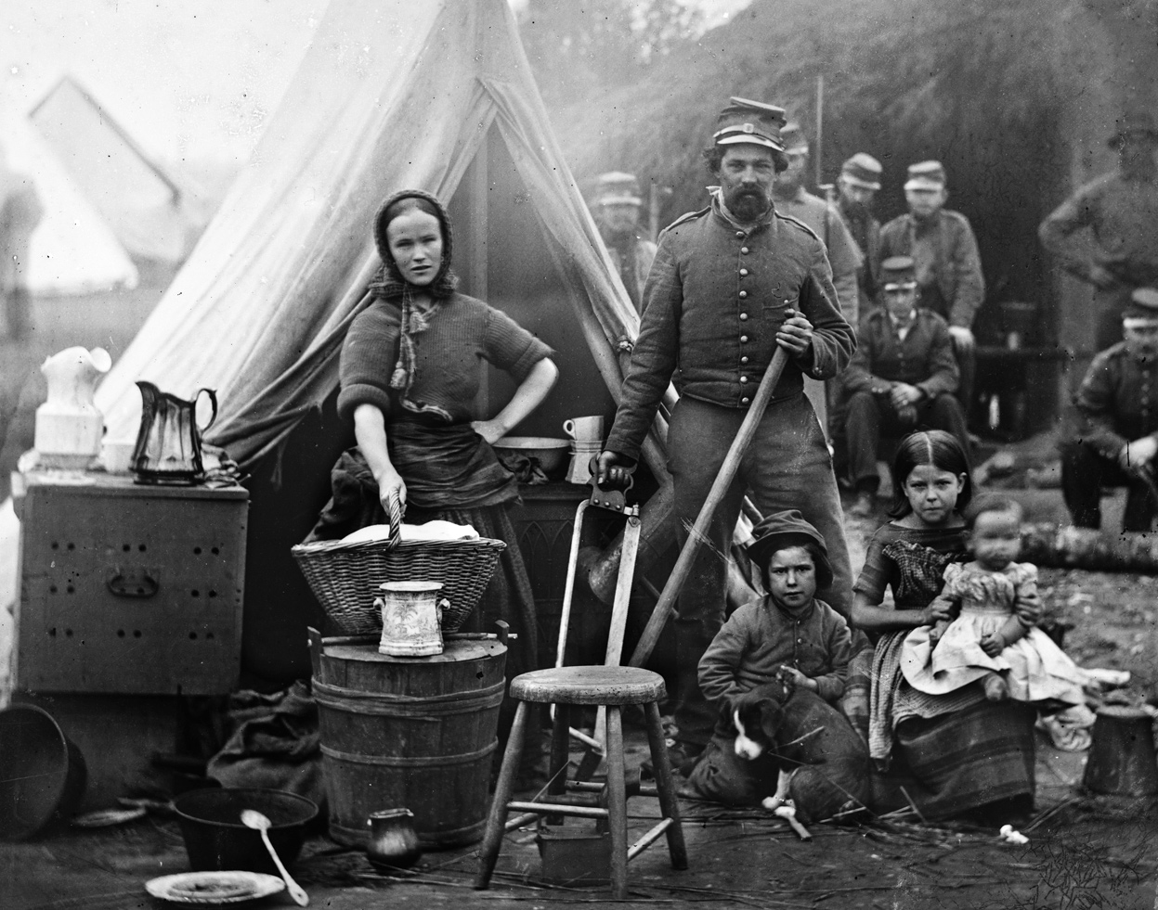
Washington D.C.
Camp of
31st Pennsylvania Infantry near Washington, D.C., 1862
The District’s population grew from 60,000 to over 200,000 during the Civil War

Slide 11
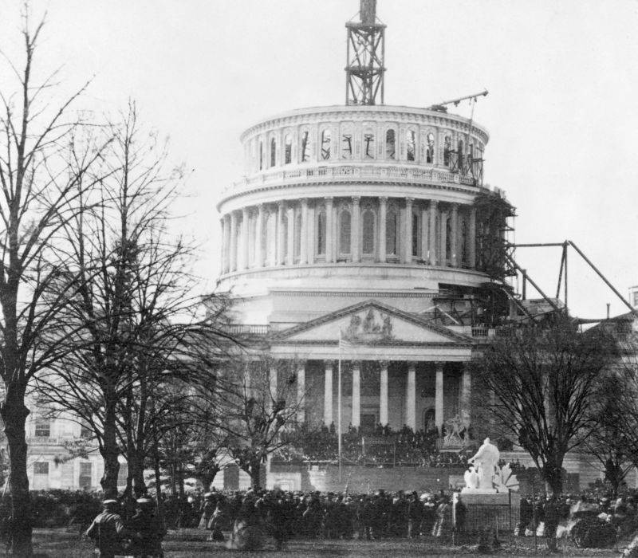
Washington D.C.
The Capital building was under construction during the Civil War, pictured here in 1861 for President Abraham Lincoln’s first inaugural address.
Padgett was 8 years, 6 months old when Lincoln first took office.

Slide 12
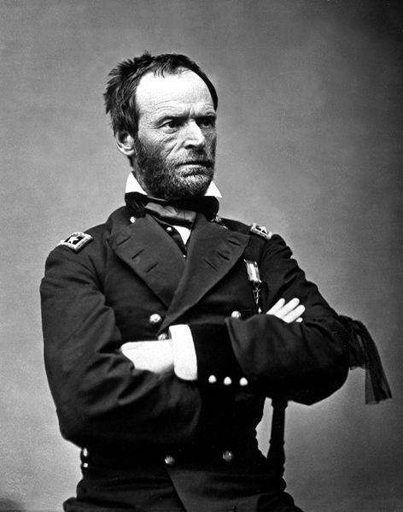
Washington D.C.
As a young man, Padgett met Union Army General, William Tecumseh Sherman.
Later, Padgett received a message via automatic writing from General Sherman. Padgett must have asked the General if he remembered their chance meeting, to which the General replied. . .

Slide 13
Washington D.C.
“Well, my dear boy, I am certainly glad that you recalled these reminiscences. Of course, with all the people that I met in those days, I cannot remember
you, as we only had a passing handshake, but I am certainly glad that you recalled those times, and more glad that I can be with you now; and things will be reversed now, for I will be the one who will
not forget, while you, considering the great number of spirits who come to you to write, and the great number who are around you ready to write, I hardly expect that you will find time to give me
much thought.”
Message from: Gen. William T. Sherman
October 9, 1915.

Slide 14
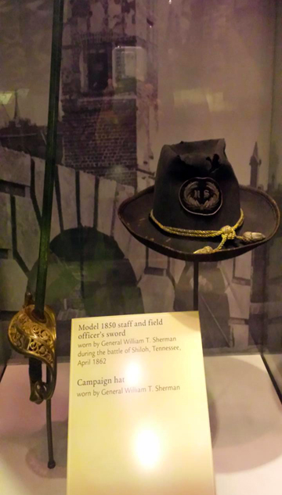
Washington D.C.

Slide 15
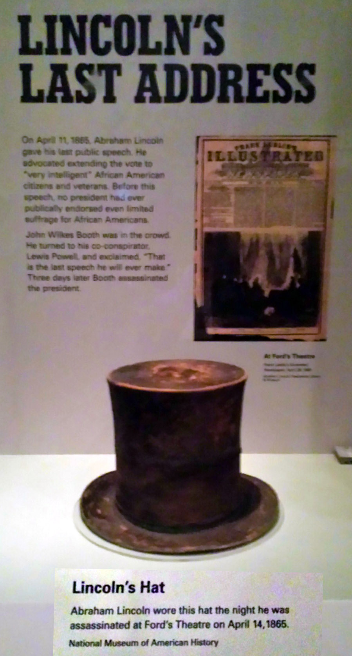
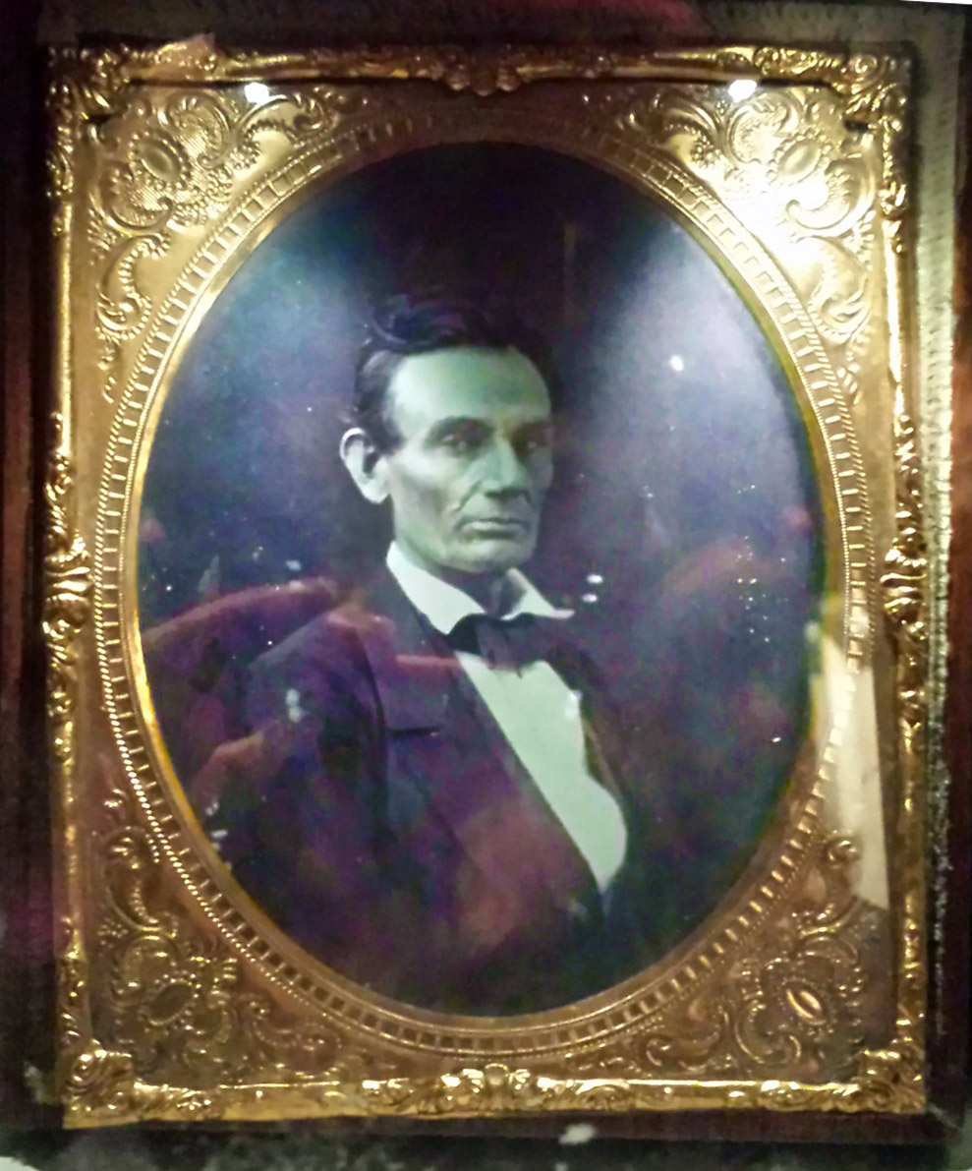
Washington D.C.

Slide 16
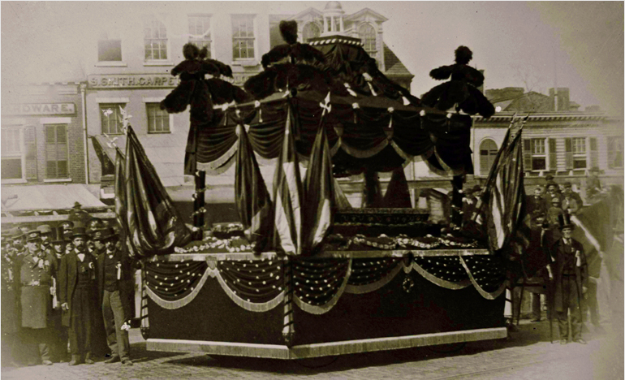
Washington D.C.
April 15, 1865, Abraham Lincoln died.
Padgett was only 12 years, 7 months old

Slide 17
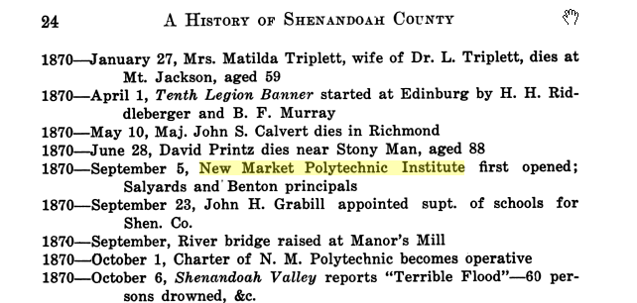
education
Padgett attended the New Market Polytechnic Institute, which opened in 1870.

Slide 18
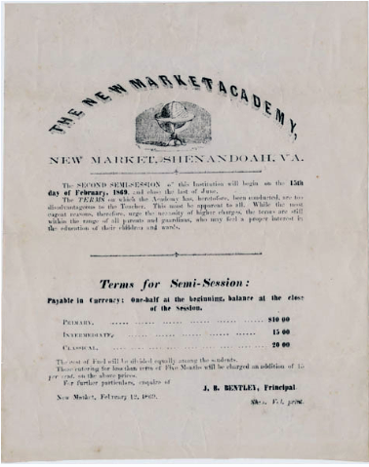
education
Padgett attended the New Market Polytechnic Institute, which opened in 1870.
The precursor to the Polytechnic Institute, was the New Market Academy, advertised her for semi-session in February 1869.

Slide 19
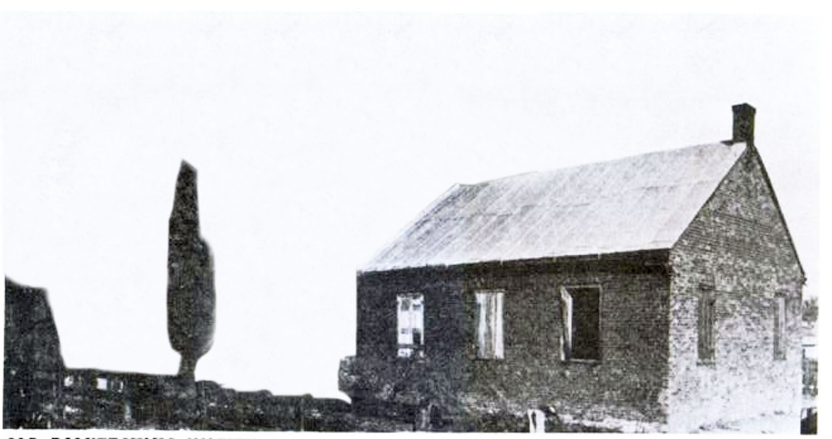
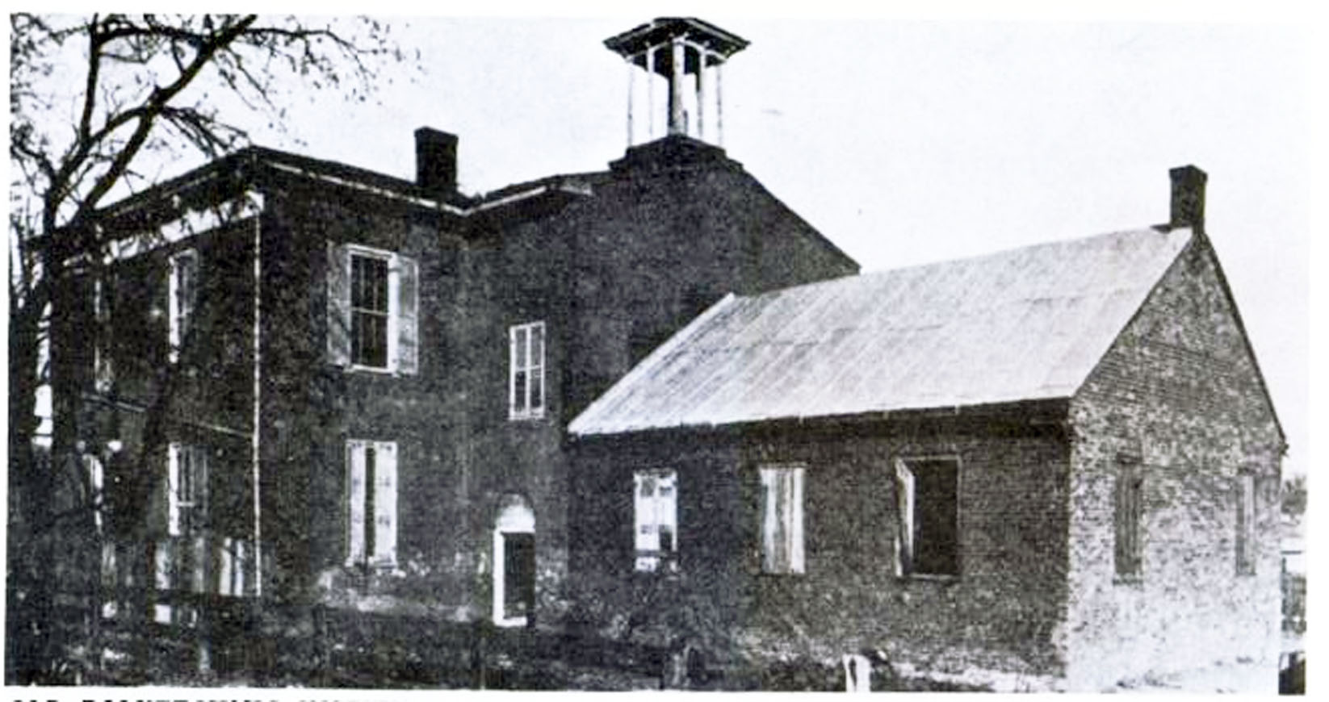
education
New Market Polytechnic Institute

Slide 20
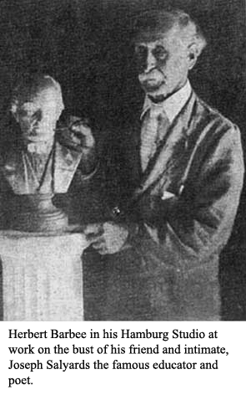
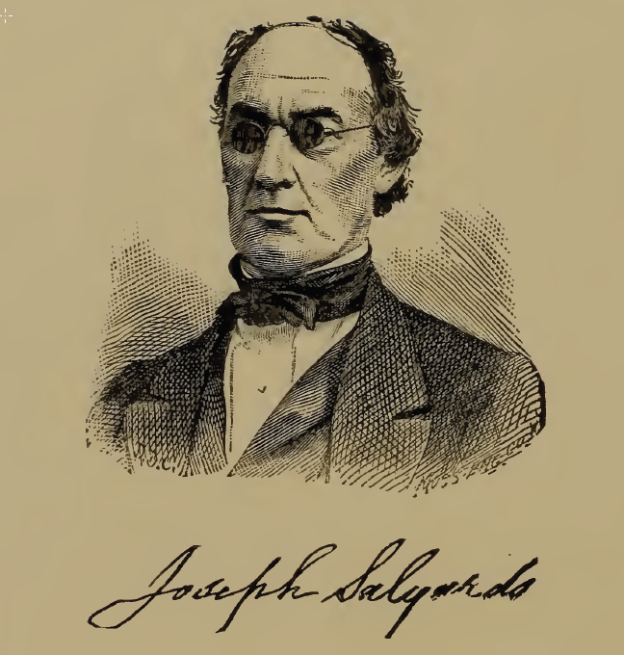
education
While attending the New Market Polytechnic Institute, Padgett became close friends with one of his professors . . .
Joseph H. Salyards

Slide 21
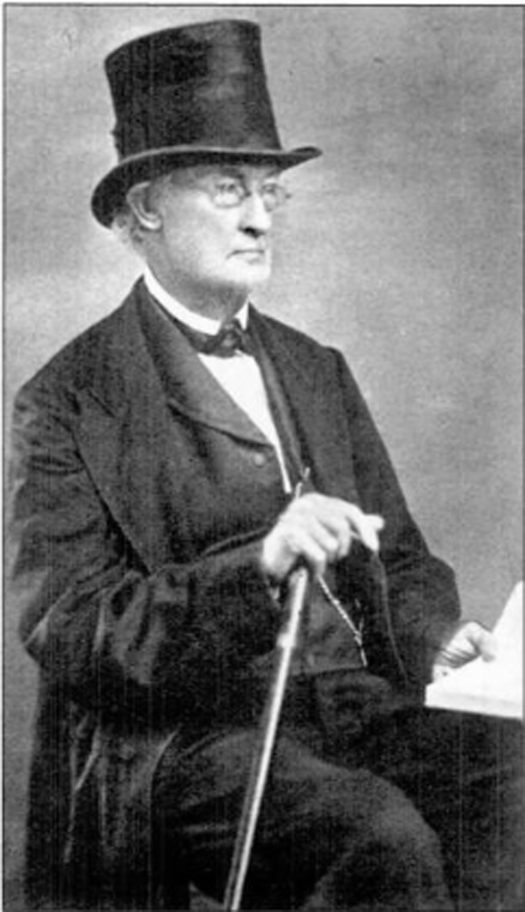
education
Professor Salyards ultimately wrote over twenty-two messages to his former student via automatic writing.

Slide 22
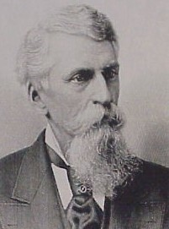
education
In 1873, Padgett began to study law with Albert Gallatin Riddle, former Republican Representative from the
19th District of Ohio.
Riddle was a friend of, and
came to Washington, D.C. with,
Abraham Lincoln.

Slide 23
education
Riddle’s daughter and his law partner, Francis Miller, were both present at Ford’s Theater the night Abraham Lincoln was shot.
Mr. Miller jumped on the stage and gave chase to John Wilkes Booth, but Booth escaped on a horse that was waiting for him in the alley.

Slide 24
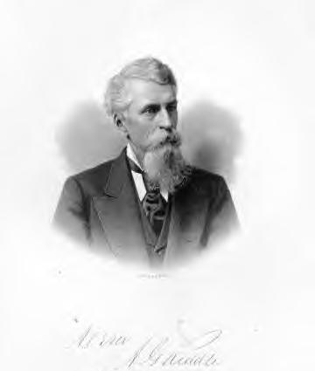
education
From 1873 to 1876, Padgett
studied law under Riddle.
In 1876, Padgett began the practice of law.

Slide 25
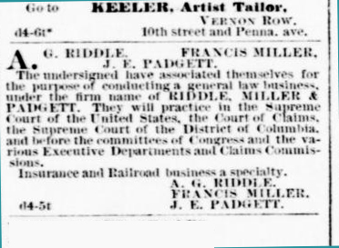
Law practice
Evening Star, December 4, 1877

Slide 26
Law practice
Some of the Law Firms that attorney, James E. Padgett was affiliated with:
Joseph Stewart and A. G. Riddle
A. G. Riddle and A. H. Thrasher
A. G. Riddle and Francis Miller
Riddle, Miller & Padgett
Riddle, Davis & Padgett
Riddle, Padgett & Davis
Riddle & Davis
James E. Padgett
Padgett & Coombe
Padgett & Forrest

Slide 27
Law practice
After Padgett developed his mediumship skills, he received messages from many of his form attorney friends and law partners.
A. G. Riddle - at least 23 messages
Edwin Forrest - at least 13 messages
Richard Ross Perry - at least 9 messages
Hugh T. Taggart - at least 5 messages
and others.

Slide 28
Law practice
In one of the earliest recorded messages, A. G. Riddle wrote:
“Yes, I am, and I will be one of the band. You will not be annoyed by any others than the ones your father has named. I will write you what my beliefs and thoughts are of the life here so that you may know that I am just a spirit in search of the truth. You will see that I am not one who knows everything, but will try to learn whatever is possible and will tell you what I learn. Yes, and will let you see that I have my mustache and goatee just as in my earthly life.”
Message from May 31, 1914

Slide 29
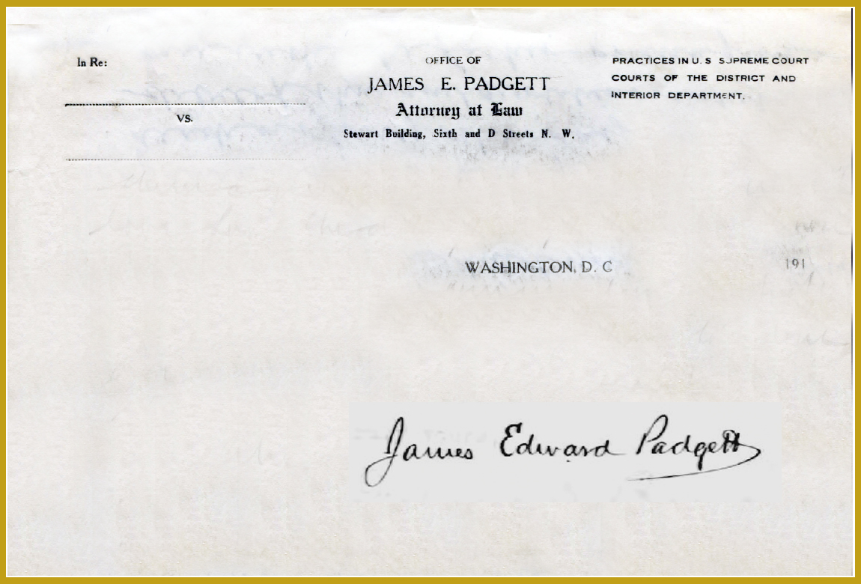
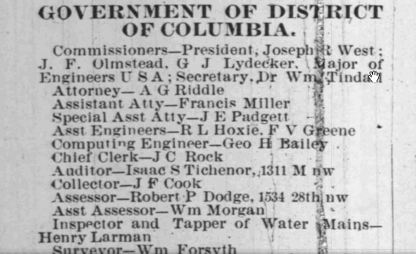
Law practice
Starting in 1877, A. G. Riddle was appointed Attorney for the Government of the District of Columbia. Riddle appointed Francis Miller as Assistant Attorney, and James E. Padgett as Special Assistant Attorney

Slide 30
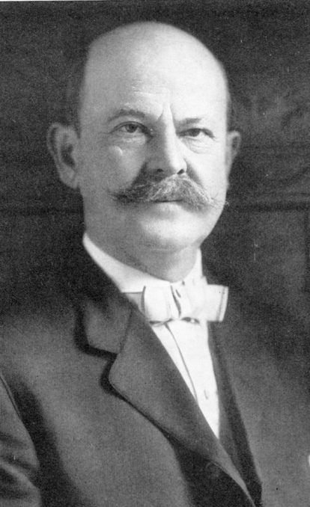
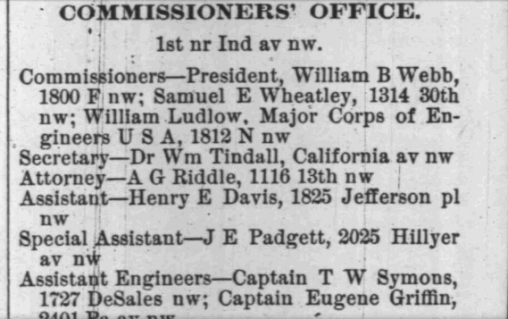
Law practice
After the passing of Riddle and Padgett’s law partner, Francis Miller, in 1888 Riddle named his son-in-law, Henry E. Davis as the government’s Assistant Attorney.

Slide 31
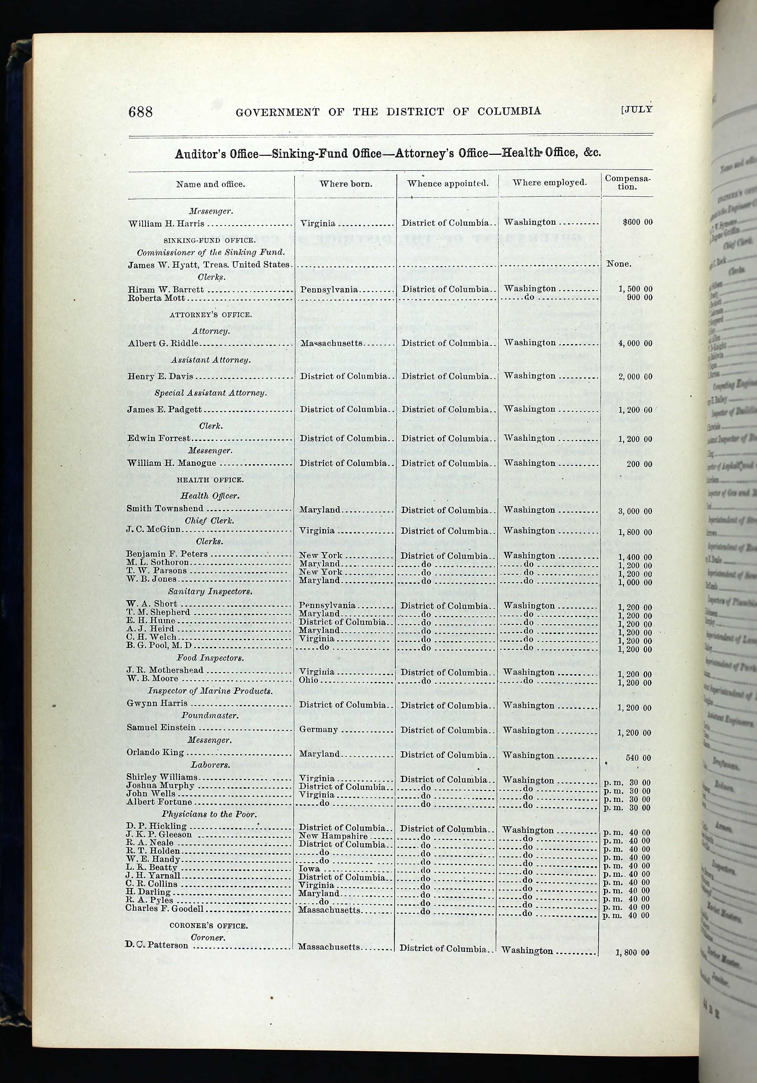
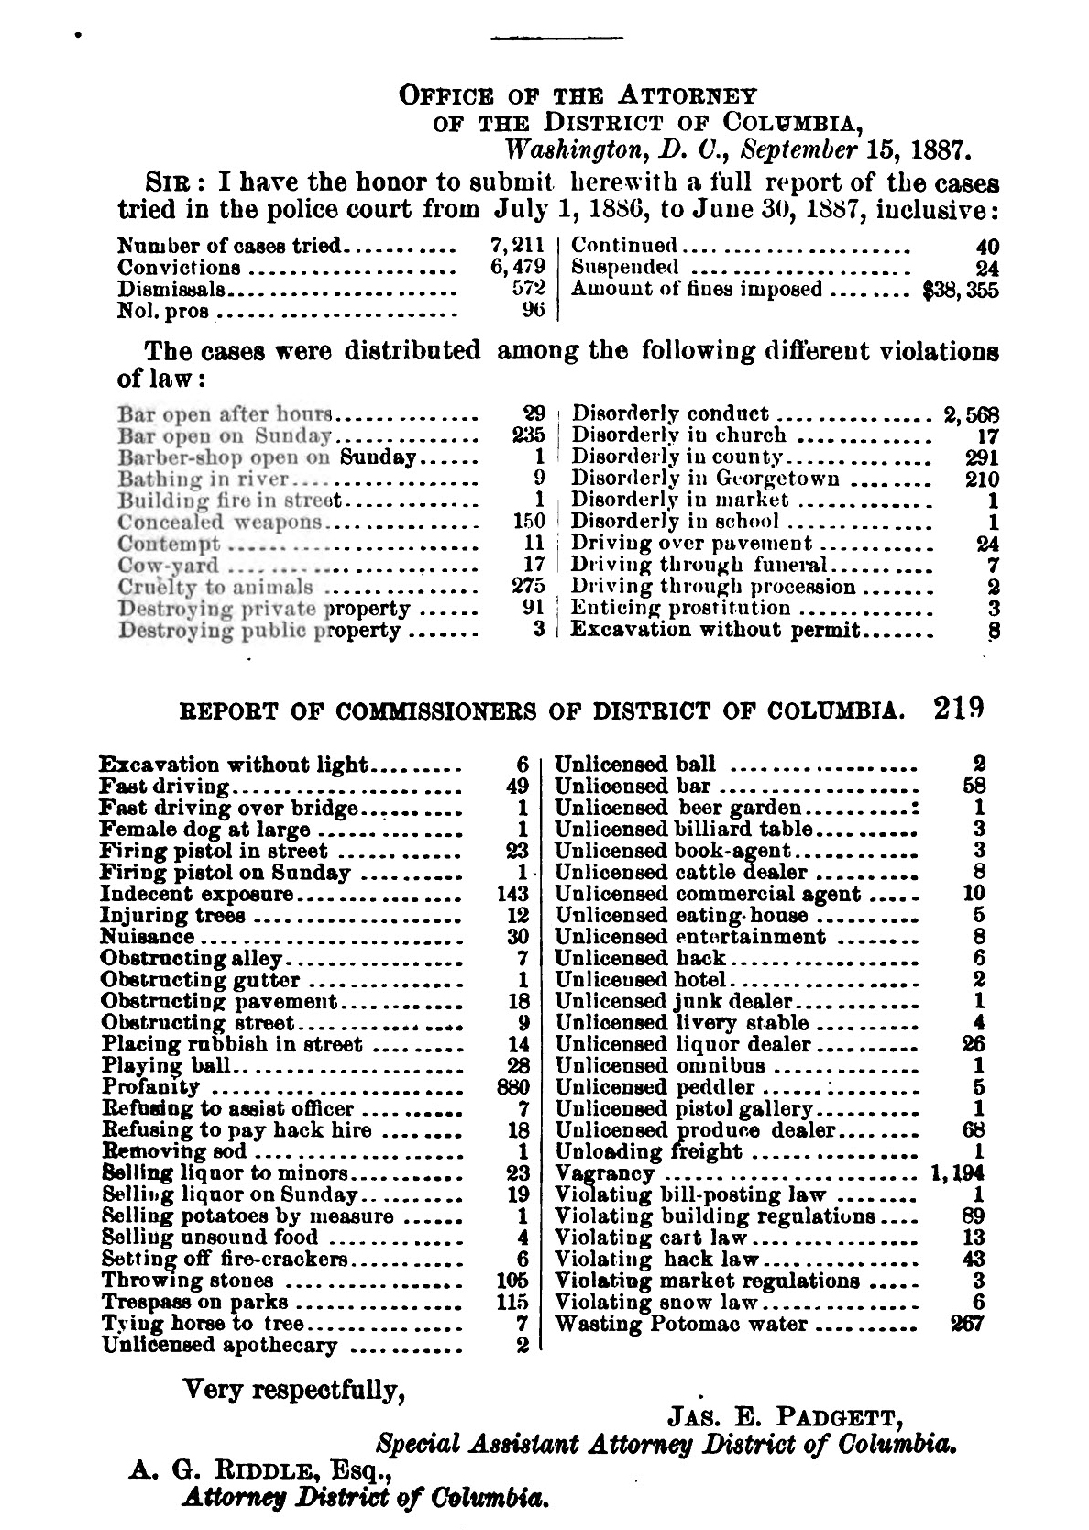
Law practice

Slide 32
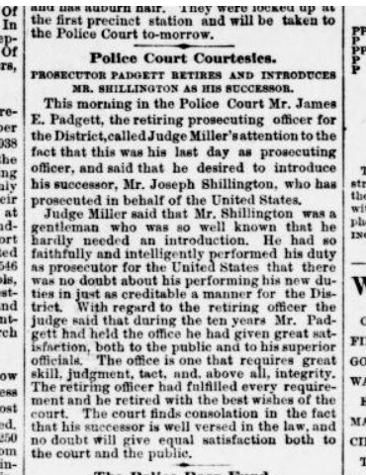
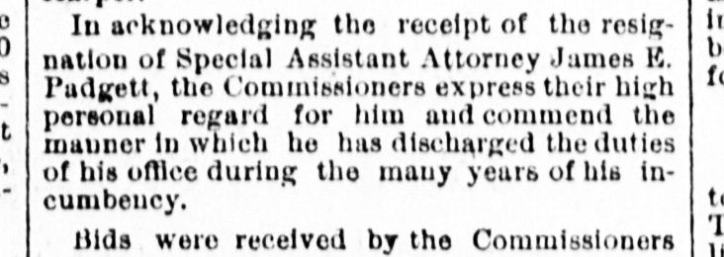
Law practice
In February 1889, James E. Padgett resigned from his position as Special Assistant Attorney. This coincided with A. G. Riddle’s leaving office.

Slide 33
Helen worman heyde
Helen was born on October 23, 1862, and
she was about 10 years younger than James.
She was the daughter of Rev. George Watson Heyde and Susan Olivia Whitehill.

Slide 34
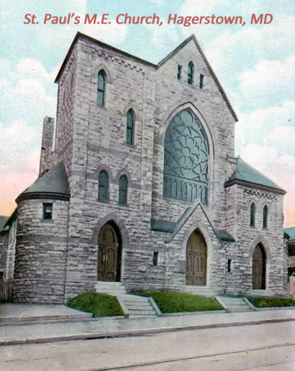
Helen worman heyde
On May 11, 1863, Helen was
baptized at Saint Paul’s
Methodist Episcopal Church
in Hagerstown, Maryland

Slide 35


Helen worman heyde
Helen was a direct lineal descendant of a man that served in the American Revolutionary War.
Because of her heritage, she and her children, grandchildren, etc., could apply for membership in the prestigious National Society of the Daughters of the American Revolution, or Sons of the American Revolution.

Slide 36
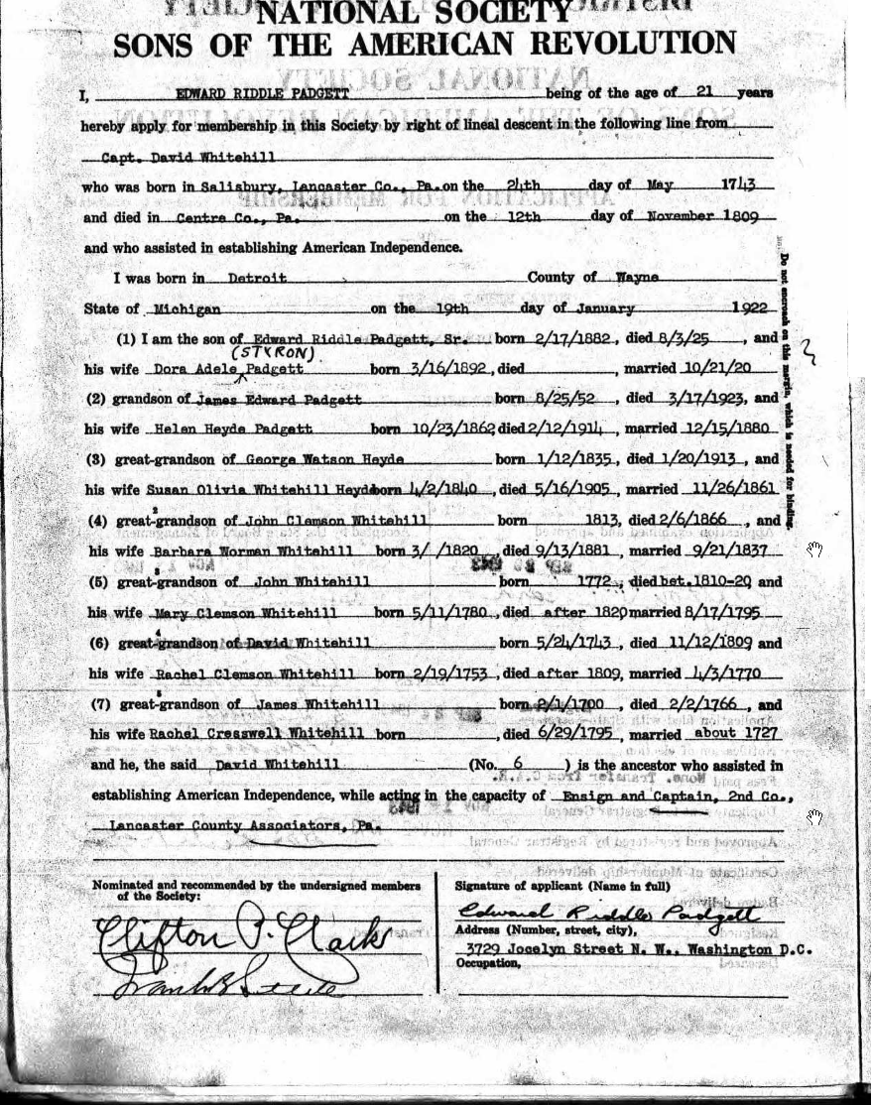
Helen worman heyde

Slide 37
Helen’s family
Rev. George W. Heyde was a Methodist minister for over 55 years. In 1864, Olivia and Rev. Heyde moved into the Methodist Episcopal Church Parsonage in Lisbon, Maryland.
Helen was only two years old and lived there until she was five years old.
We were fortunate enough to find these photos…

Slide 38
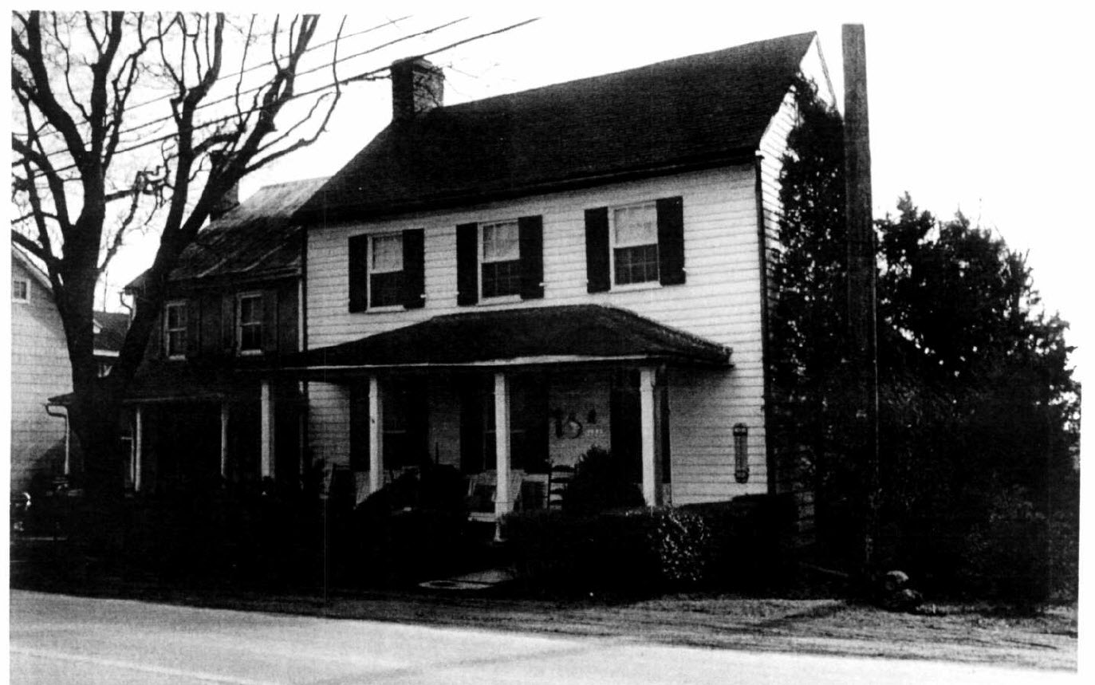
Helen’s family

Slide 39
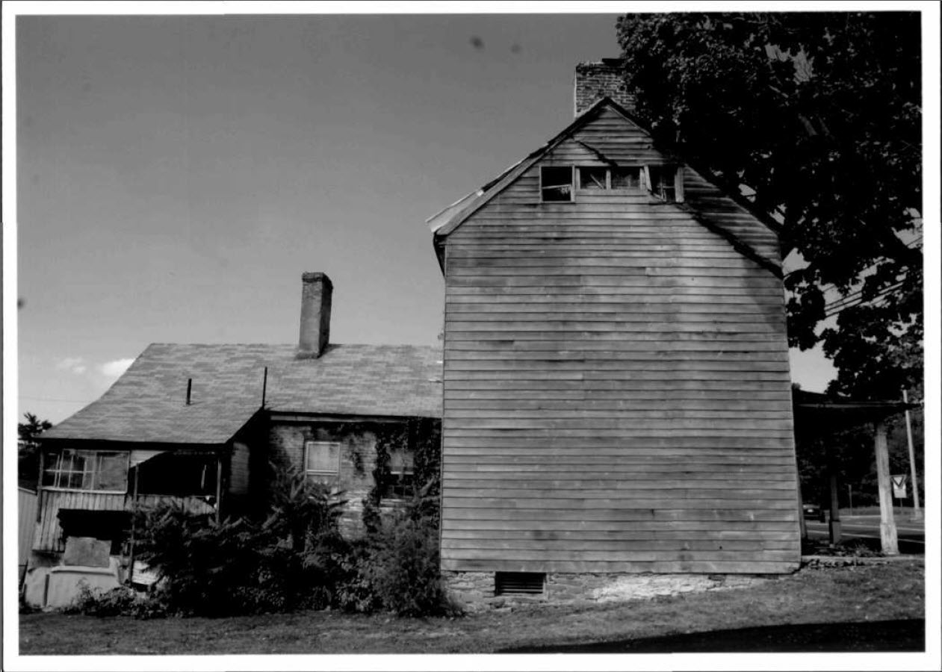
Helen’s family

Slide 40
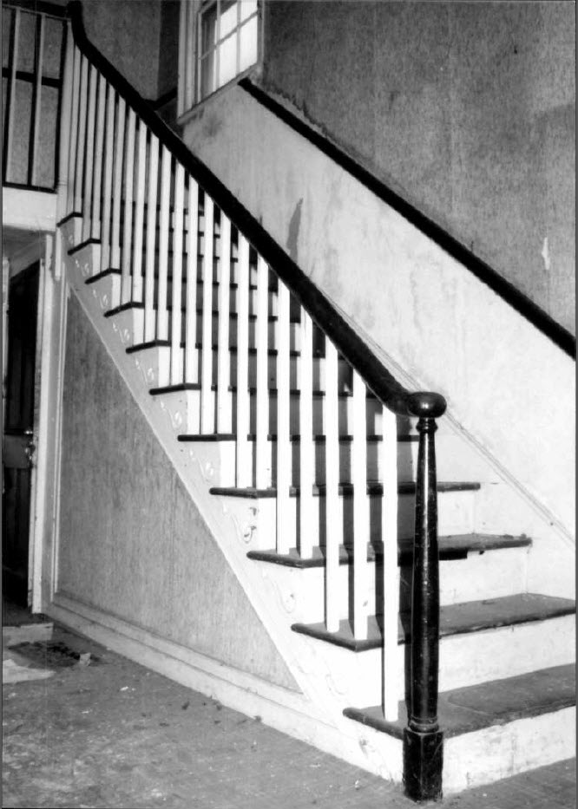
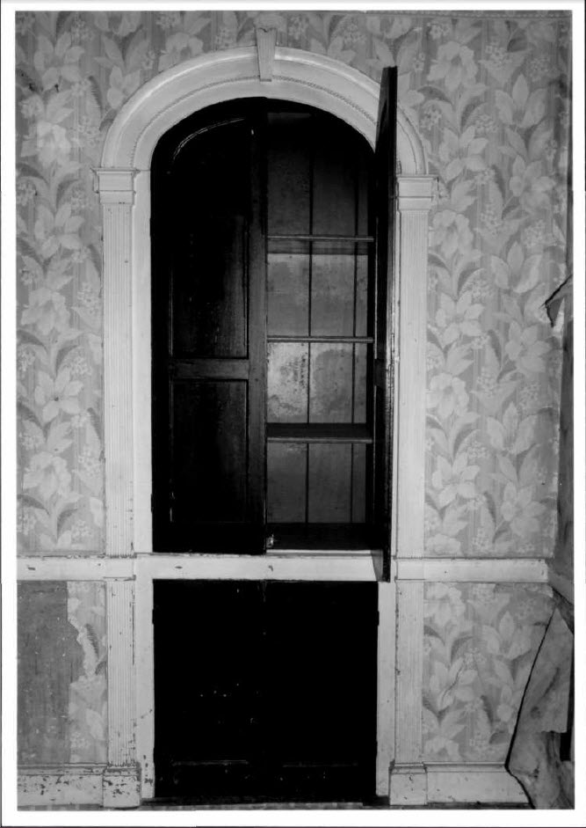
Helen’s family

Slide 41
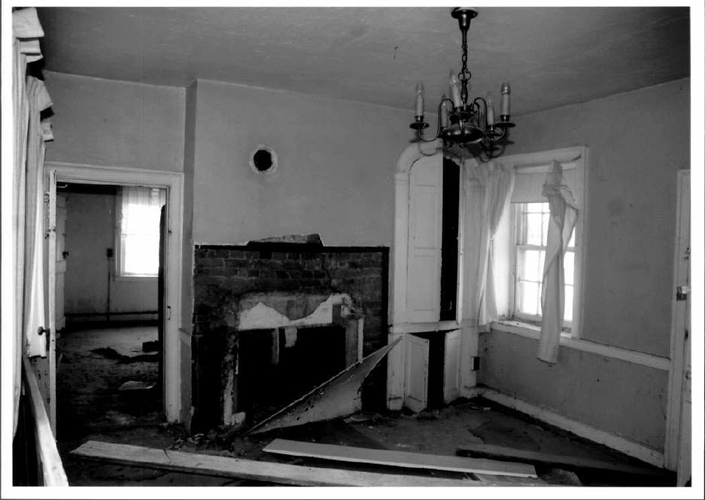
Helen’s family

Slide 42
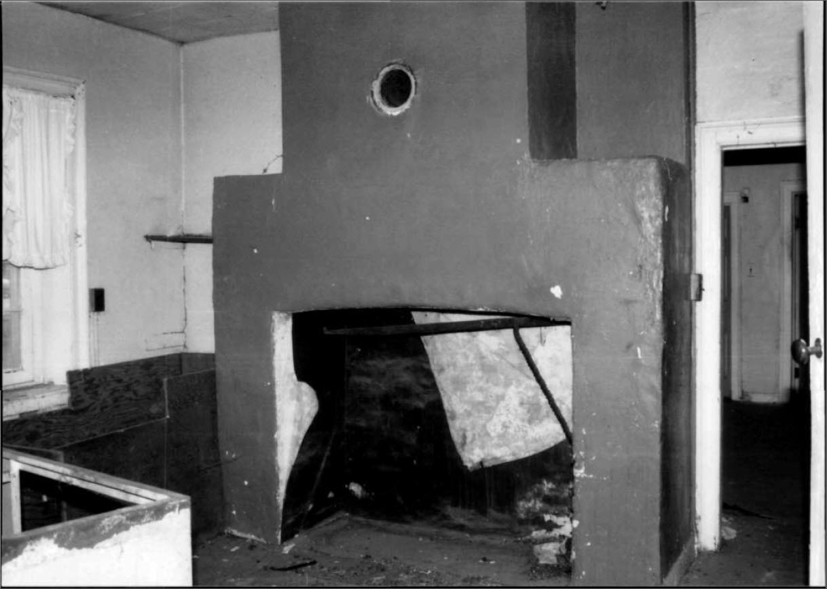
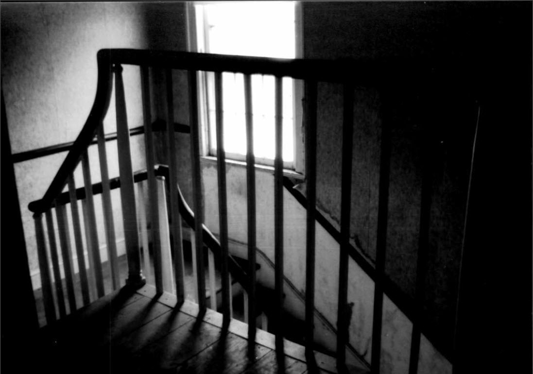
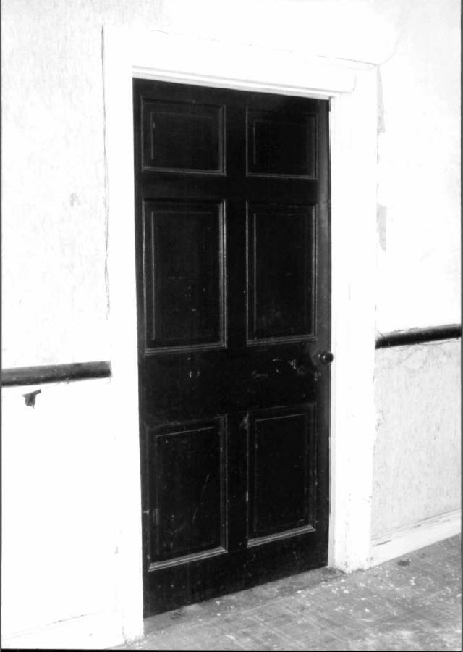
Helen’s family

Slide 43
Helen’s family
We know from U.S. Census records that in 1870, the Heyde’s lived in Hancock, Maryland, and Helen was about 8 years old.
From the 1880 Census we learned that the Heyde’s moved to Washington D.C. Helen, now 17, was living with her mother, and father, and also a younger brother, Eugene Whitehill Heyde age 9, and a younger sister, Nancy (Nannie) Morgan Heyde age 7.

Slide 44
Helen’s family
What the Census does not tell us is that George and Olivia Heyde had two other sons after Helen was born.
Walter Clemson Heyde, 1865 to 1868
and
Howard Heyde, 1869 – 1869, only three-months old

Slide 45
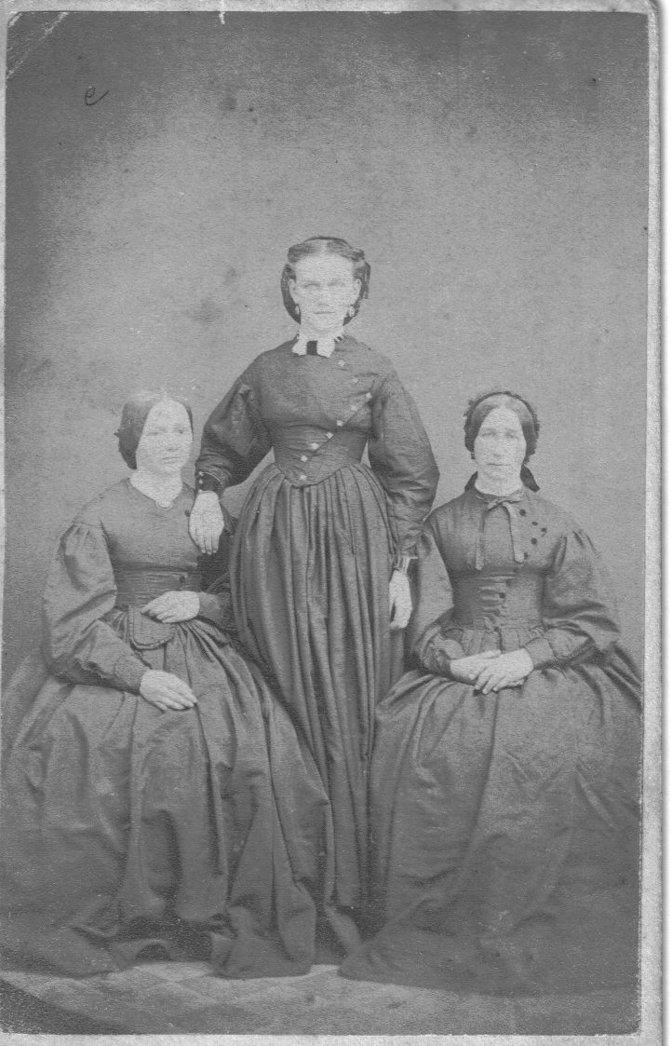
Helen’s family
Rebecca, Mary & Elizabeth Heyd – Helen’s aunts

Slide 46
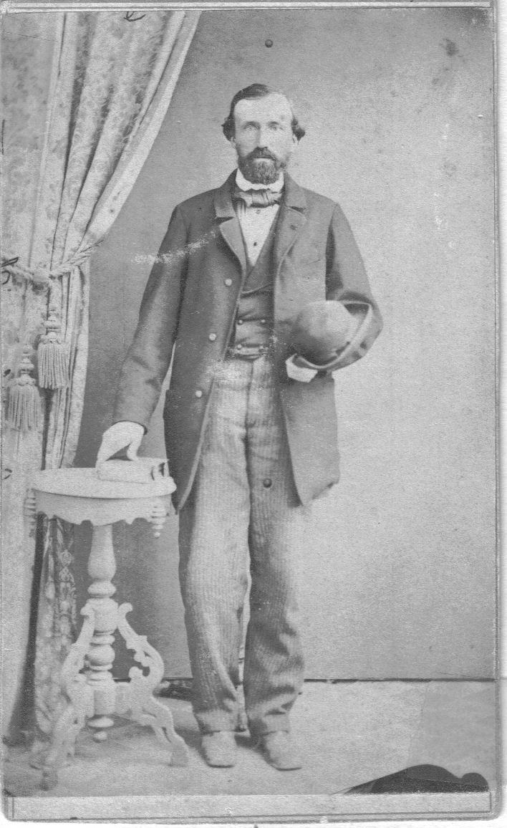
Helen’s family
Jacob Heyd, Helen’s uncle

Slide 47
Helen met JAMES
In 1880, while living in Washington D.C., a young Helen Worman Heyde was introduced to a dashing young attorney, James Edward Padgett
After a brief courtship, the two married on December 15, 1880.

Slide 48
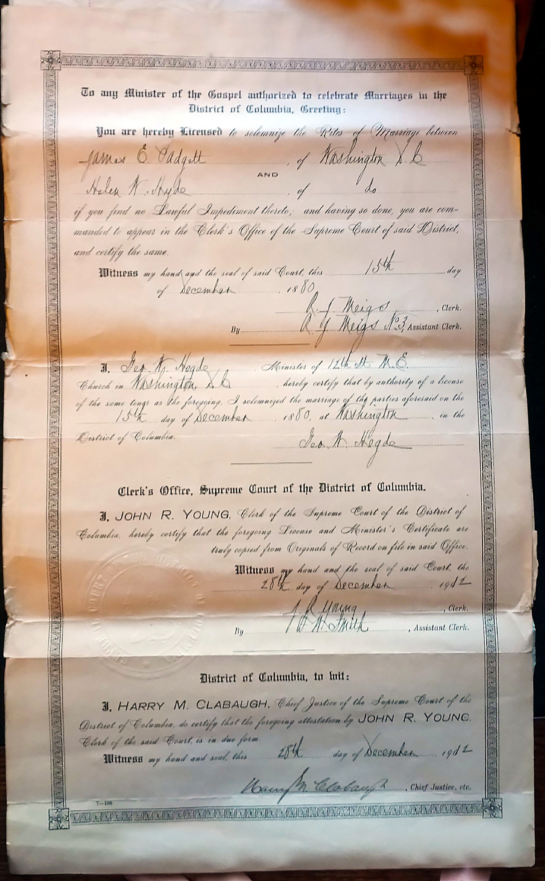
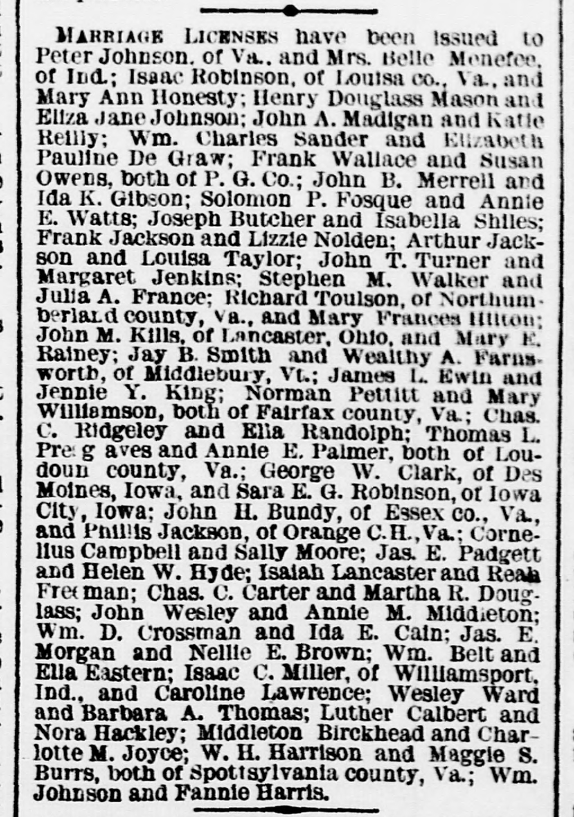
Marriage license

Slide 49
Then came the Padgett children . . .
Edward Riddle Padgett
Harry Heyde Padgett
Helenita Padgett

Slide 50
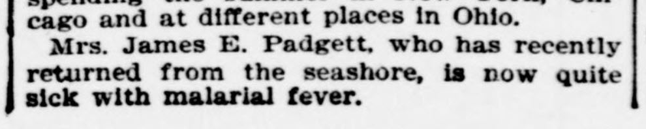
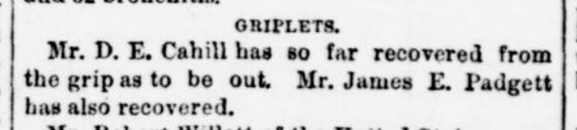
Padgetts in the news
The Evening Star, Sept. 2, 1893
The Evening Star, Jan. 22, 1890

Slide 51
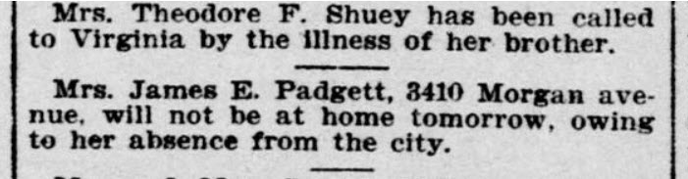
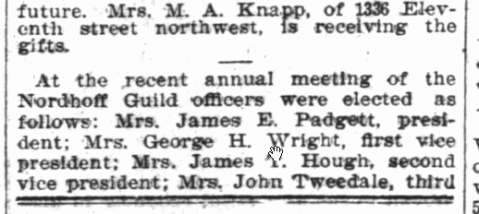
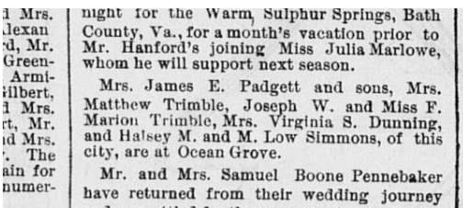
Padgetts in the news
The Washington Post, Nov. 19, 1905
The Evening Star, March 10, 1904
The Sunday Herald, July 19, 1891

Slide 52
Edward riddle Padgett
Edward was born on February 17, 1882
He attended Emerson Institute, graduating in 1901.
St. John’s College, Annapolis, MD (1901-1904)
Graduated with Bachelor of Arts degree; ranked 4th in his Class of 19.

Slide 53
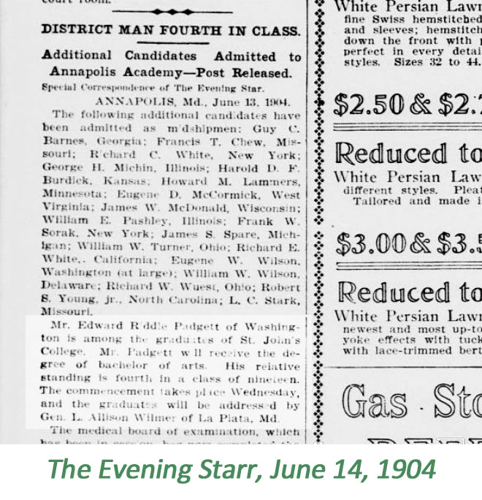
Edward riddle Padgett

Slide 54
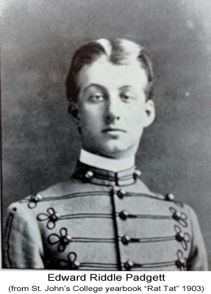
Edward riddle Padgett

Slide 55
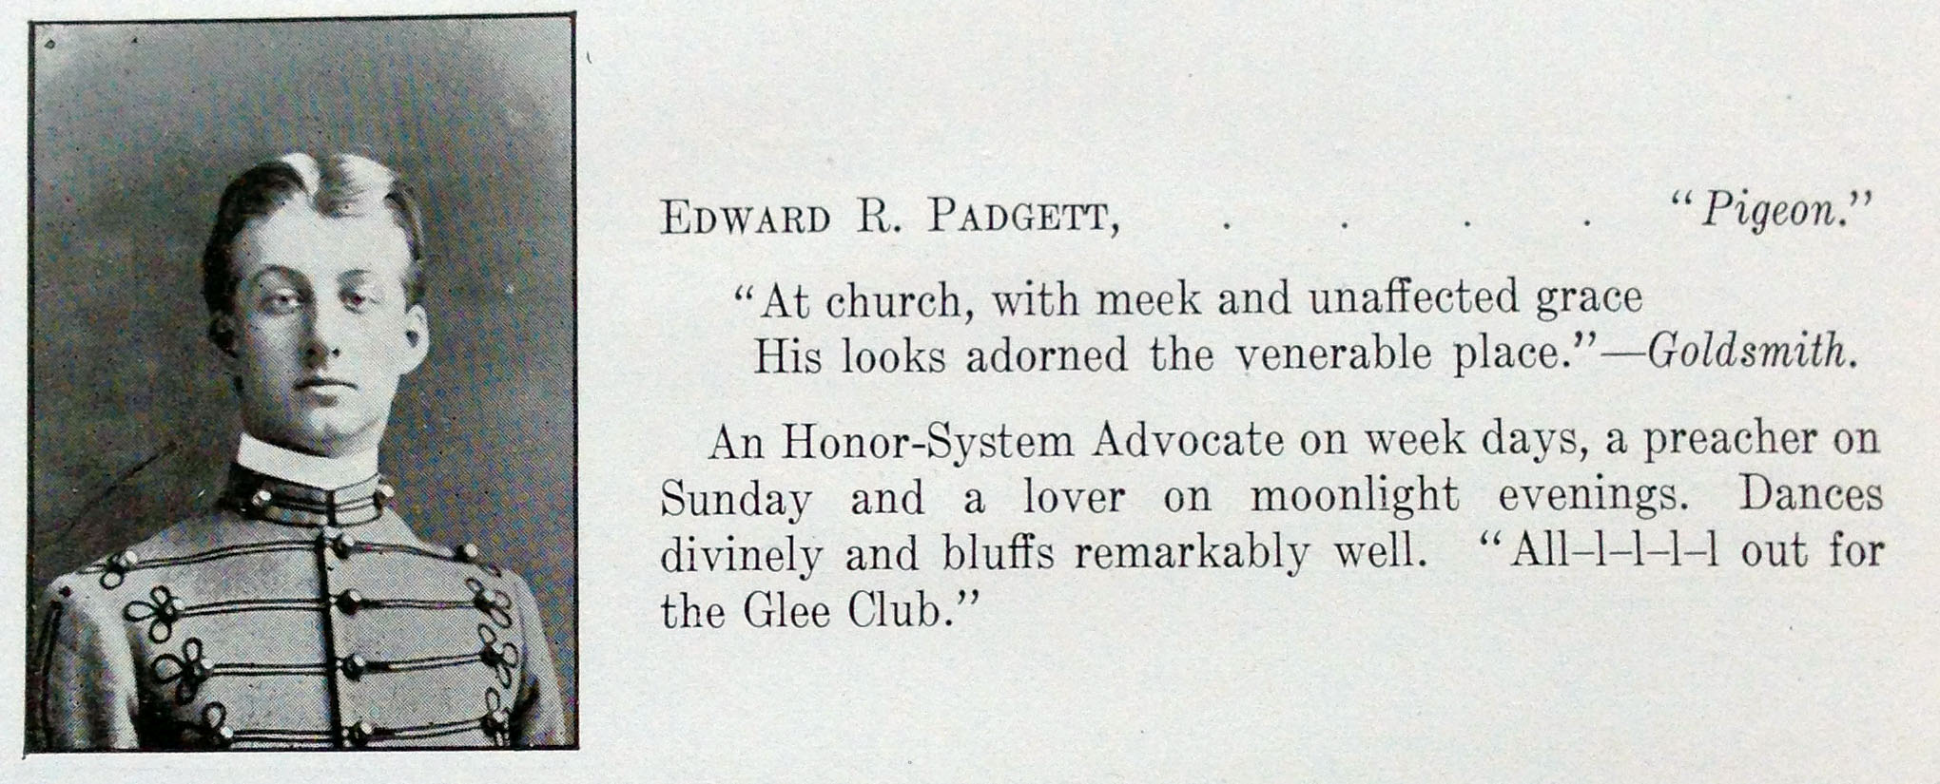
Edward riddle Padgett

Slide 56

Edward riddle Padgett

Slide 57

Edward riddle Padgett

Slide 58


Edward riddle Padgett

Slide 59

Edward riddle Padgett

Slide 60

Edward riddle Padgett
Edward entered the Divinity School of the Protestant Episcopal Church in Philadelphia

Slide 61

Edward riddle Padgett
At St. Johns, Edward became interested in writing and was Associate and Assistant Editor of the Rat Tat.

Slide 62

Edward riddle Padgett
Washington Times, October 5, 1908

Slide 63

Edward riddle Padgett
Edward married Margaret C. Cooper
December 16, 1908

Slide 64

Edward riddle Padgett
August 6, 1914, Edward married Edith Crane

Slide 65

Edward riddle Padgett
World War I
In July 1916, Edward applied for a commission as
Captain in the Military Intelligence Branch of the Army
Edward served under
Colonel Marlborough
Churchill, a distant relative
of Winston Churchill.

Slide 66


Edward riddle Padgett

Slide 67


Edward riddle Padgett
After the war, Edward moved to Detroit, Michigan
Edward fell in love again, and on October 20, 1920, Edward married Dora Adele Styron (Simpkins)

Slide 68

Edward riddle Padgett
Edward and Dora had a child. . .
Edward Riddle Padgett, Junior!
Born on January 19, 1922

Slide 69

Edward riddle Padgett
Edward and Dora returned to D.C. area when they moved to Baltimore, Maryland, and Edward accepted the position of Sunday editor of the Baltimore Sun newspaper.
However, on August 3, 1925, Edward suddenly died from a heart attack in their home in the University Apartments. He was just shy of forty-three and one-half years old.
Edward Riddle Padgett was survived by his widow, Dora Adele Padgett, and his three and one-half year old son, Edward Riddle Padgett, Jr.

Slide 70
Harry heyde Padgett
James and Helen’s second child was another son, Harry Heyde Padgett.
Harry was born on February 6, 1884, almost exactly two years after Edward was born.

Slide 71

Harry heyde Padgett
The Padgett boys were close,
and they enjoyed sports,
music and singing.
Around 14 & 16 years of age,
“Choir Take An Outing”

Slide 72

Harry heyde Padgett
Harry kept his love of music, and when he joined his brother at St. John’s College, he too was in Glee Club and more!

Slide 73


Harry heyde Padgett

Slide 74


Harry heyde Padgett

Slide 75

Harry heyde Padgett
Here is how Harry’s college classmates described him. . .

Slide 76

Harry heyde Padgett

Slide 77

Harry heyde Padgett

Slide 78

Harry heyde Padgett
From Directory records, Harry, now going by the name “Henry”, moved to Baltimore in 1903 after he left St. John’s
By 1910, Harry had moved to Chicago. He was 26 years old, single, and working as a clerk in the Railroad Industry

Slide 79

Harry heyde Padgett
On June 3, 1911, Henry married Hazel Kirke Hamilton

Slide 80

Harry heyde Padgett
World War I
With his Railroad Business background, Henry Padgett landed a position with the newly nationalized “United States Railroad Administration.”
Henry served as secretary
to Walter D. Hine,
Assistant Director General
of the USRA.

Slide 81

Harry heyde Padgett
World War I
Henry Padgett registered: September 12, 1918

Slide 82
Harry heyde Padgett
In a side bar note, Helenita must have liked Hazel because after she passed she wrote in one of the messages through her father. . .
“Give my love to the boys, and especially to Hazel and tell her that I am with her, and so is mother, both trying to help her, and make her expectations come true, and also cause her to be the happiest little mother in all the world. She has wonderful influences around her, and should be very happy as well as should Harry, and I know you will also. So, dear Daddy, I must say good night. With all my love, I am still your own loving – Baby.”
-- Message from Helenita Padgett on October 14, 1918

Slide 83
Harry heyde Padgett
While still living in the Washington D.C. area in 1919, Henry and Hazel welcomed their first child…
  Barbara Padgett

Slide 84


Harry heyde Padgett
The 1920 Census shows that Henry, Hazel and Barbara had moved to town called Rye, New York.
Subsequently, Henry obtained a job with the Tide Waters Oil Company of New York City.
Henry’s new job required him to travel abroad, so he needed to obtain a United States Passport

Slide 85



Harry heyde Padgett
Later the same year, Henry sends for his bride, Hazel, and his newborn girl, Barbara. Of course, they needed a passport too!

Slide 86


Harry heyde Padgett
While in Mexico, Henry applied for a second passport!

Slide 87


Harry heyde Padgett
Henry and Hazel had a second child
On September 10, 1921, Hazel gave birth to
Harriet Padgett.
The Padgett family moved west to California, settling in the City of Glendale
The girls attended Glendale High School

Slide 88


Harry heyde Padgett
Both of the Padgett grandchildren went on to get married and have families.

Slide 89


Harry heyde Padgett
On December 9, 1953, Hazel Padgett passed away.
Henry, who traveled frequently for his work, fell in love with Honolulu, Hawaii. After he lost Hazel, Henry moved to Honolulu, where he died 16 years later at the age of 85.

Slide 90

Harry heyde Padgett
The family brought Henry’s remains back to California so he could be buried with his loving wife, Hazel.

Slide 91
helenita Padgett
Just a couple of weeks after Helen’s Thirtieth birthday, she gave birth to the Padgett’s third child.
James was a couple of months past 40 years old.
Born November 8, 1892
Helenita Padgett

Slide 92

helenita Padgett
According to the 1900 Census, the Padgett’s were living all together at 1341 Kennesaw Avenue, along with a servant named Annie Wilson.
Helenita attended the Hubbard School for her elementary schooling

Slide 93

helenita Padgett
Helenita shared musical talents, like her brothers.
On June 12, 1905, we found the following newspaper clip

Slide 94


helenita Padgett
Helenita promoted to high school on June 21, 1906.
She attended Central High School, in Washington D.C.

Slide 95


helenita Padgett
In June of 1909, Helenita promoted from Sixth to Seventh grade at Central High, and by the fall, Helenita had taken up the sport of Tennis.
In October 1909, Helenita was elected “Manager” of the girls Tennis Team

Slide 96



Slide 97

HELENITA PADGETT
“Dutch;” “Nita,” F8
“To know her is to love her, Love but her and love forever. Nita’s greatest talent is that of making people love her, and she’s a sure enough genius at that. You just can’t help liking her, for she is mighty near the sweetest little girl that ever happened. Nita doesn’t seem to have any very high and lofty ambition, but if she just goes on through life dispensing sweet smiles and sunshine as she has done at Central, she will have heaps more influence than any amount of suffragettes; so keep it up, Dutch.”
Helenita graduated from Central High School on June 23, 1910

Slide 98


helenita Padgett
Census of 1910

Slide 99

James e. Padgett
Sometime after moving into the Stratford Hotel, James and Helen separated.
Helen & Helenita moved to an apartment on Adam Mills Road.

Slide 100
Padgett’s in the news
Helen obtained a job at the Assessor’s Office for $2.50 per day, but it was not a full-time job nor permanent.
On November 4, 1912, Helen filed for a divorce seeking alimony.
Helen was sick for several months during the course of the dissolution proceeding

Slide 101

Helenita in the news
Meanwhile, Helenita was having some fun. . .
Helenita in a wedding in October, 1910

Slide 102

Helenita in the news
Helenita in another wedding in March, 1911

Slide 103

Helenita in the news
Helenita dined with her Phi Delta Sigma Society in
Feb. 2, 1913

Slide 104
Helen’s passing
On a Thursday morning, the
12th of February, 1914,
Helen Worman Heyde Padgett died in a Wernersville, Pennsylvania sanitarium from complications due to
Aortic Regurgitation.
She was only 51 years, 3 months and 20 days of living in the material world.
The obituary below appeared in the Washington Herald on the following day.

Slide 105

Helen’s passing

Slide 106

Helen’s passing

Slide 107
Helen’s passing
We do not know how much, or if at all, James and Helen met while they were separated.
However, in one of Helen’s messages through her husband’s mediumship,
she wrote the following. . .

Slide 108
Helen’s passing
“Many times after we had separated did I read those wonderful letters of love in which you poured out your heart’s true love to me, and found much consolation in them and wished so often that the love might be with me again as it was when I had all your love.
They were very precious to me and made me live again in the happiness of the past and wished that you were still my own dear Ned, as you were when they were written.”
-- Helen Padgett, in a message dated November 2, 1921

Slide 109

Helen’s passing
We do know definitively that Helen and James were still married at the time of her death.
With the long illnesses of Helen, the court case was never completed and the case was dismissed.

Slide 110



Helenita tries to move on
After her mother’s passing, Helenita moved to Chicago to be near Henry & Hazel.
She enrolled in the University of Chicago

Slide 111

James – the medium
After Helen passed, James attended séance and met Mrs. Maltby, who told him of his gift.
Published
Feb. 13, 1914

Slide 112

James – the medium
After Helen passed, James attended séance and met Mrs. Maltby, who told him of his gift.
Published
March 28, 1914

Slide 113

James – the medium
One of the books that James read regarding mediumship.

Slide 114



James – the medium
James became friends with the Colburns
Arthur Colburn, the son, was an attorney as well.
Helen Lockwood Colburn (mother) and Helen Colburn (daughter) were both artists & mediums.
Helen’s sister, Frances Lockwood Brundage, was a successful worldwide commercial artist.

Slide 115
The Colburns
The Colburns were Spiritualists/Mediums and held frequent séances at their Takoma Park home
Besides being an attorney, Arthur Colburn was a mathematician, inventor, medium and photographer.
The following photos are from his personal Colburn family album.

Slide 116

The colburns

Slide 117




The colburns

Slide 118

Colburns
Arthur Colburn
not only an attorney, but also a mathematician, inventor, photographer, and
a medium

Slide 119

Colburns
Helen Frances Colburn
An Artist & Medium

Slide 120

Colburns
Helen sits on the “spirit bench”

Slide 121

Colburns
Arthur and Rollinson Colburn

Slide 122

Dr. Leslie r. stone
Dr. Leslie Rippon Stone
Came to Washington D.C. in 1912
Studied at the Buffalo State Hospital, becoming a graduate nurse.

Slide 123
Dr. Leslie r. stone
From his own testimony, Dr. Stone states he met James Padgett through Arthur Colburn.
“I became acquainted with the Colburns through Mr. Plummer. I found them very kind and lovable people who were greatly interested in psychic experiences. It was through their son, Arthur Colburn, that I first heard of the messages that were being received by Mr. Padgett.”
-- Dr. Leslie R. Stone, Testimony TGRABJ pg. xxii

Slide 124

Dr. Leslie r. stone
Dr. Stone studied at the Palmer Gregory College of Chiropractic in Oklahoma City

Slide 125

Dr. Leslie r. stone
Dr. Stone said that
Mr. Plummer was looking
for the author of a book. . .
“Was Abraham Lincoln
a Spiritualist?”

Slide 126

Dr. Leslie r. stone
Dr. Stone said that he first met James Padgett at his office in the Stewart Building on 6th and D Streets, N.W.

Slide 127

Dr. Leslie r. stone
The 1920 Census shows that Dr. Stone was then living with the Colburns

Slide 128



Friends & associates
“I AM HERE, George W. Harvey:
I lived in Washington, and kept a restaurant on Pennsylvania Avenue and Tenth Street. I am in the spirit world and in the earth plane and in hell also, I am not happy for I am in darkness and despair.” TGRABJ Vol. 4, pg. 196, Jan. 12, 1915

Slide 129

Friends & associates
“I am General Grant. I was the President of your country and also the General of the Federal armies. Well, I want to say that I am in a condition of comparative happiness, but not entirely relieved from my darkness or sufferings. I had a great many sins to answer for and many penalties to pay, and during the years since my death I have suffered much and experienced great darkness. But thanks be to God, I am emerging from these conditions and am having my spiritual eyes opened to the truths of God and the necessity of obtaining His Love and Favor.” TGRABJ Vol.. 3, pg 110, Oct. 19, 1915

Slide 130

Friends & associates
“Well, as Grant and I are very close friends here, as we were on earth, I thought that as he wrote a letter I would like to do so also. Just as he said about himself, I say, I am in some darkness and suffering - paying the penalties of my evil deeds on earth, and for what I neglected to do in the way of performing my duties when I had so many to perform, and so many opportunities…” TGRABJ Vol.. 3, pg 111, Oct. 19, 1915

Slide 131

Friends & associates
“I am here, Garfield. I am J. A. Garfield, your old partner’s friend. I want to say that you are a very much favored man in having so many spirits of such high degree of development interested in you and your work as a medium.
I have been with Mr. Riddle a great deal, and he tells me of the wonderful powers you have received in taking these communications, and the wonderful truths that have been communicated to you; and what great faith you have in prayer to the Father.” TGRABJ Vol.. 3, pg 114, Mar. 22, 1922

Slide 132

Friends & associates

Slide 133
Friends & associates
“I was also to some extent a spiritualist — that is I believed in the communications of spirits with mortals, as on numerous occasions I have had such communications, and have acted on advice that I received through them. But I never learned from any of these communications any of the higher truths which I now know, and which are so important for mortals to know, and which, if men only knew and taught, would make their religion a live, virile, all pervading and satisfying religion. We are all interested in your work, and are co-workers with you in revealing these great truths. May God bless and prosper you and cause you to see the realities of the great Divine Love, is the prayer of your brother in Christ,
A. LINCOLN.” TGRABJ Vol.. 1, pg. 264, Jan. 5, 1916

Slide 134




Friends & associates
“Poor Perry is still in darkness. It is a hard matter to
convince him of the truths of salvation, but we are
all trying to help him.”
Albert G. Riddle TGRABJ Vol.. 3, pg. 282, Sep. 24, 1915
“My, friend, for such I believe you to be or you would not be able to interest yourself in me as you have. I want to tell you that if I only again could shoot myself and by that means end my existence, I mean annihilate my spirit and soul, so that they would go into nothingness, I would gladly and quickly pull the trigger and send the bullet into that spot which would bring about the desired effect.”
Richard Ross Perry TGRABJ Vol.. 3, pgs. 328-330, Oct. 1, 1915.

Slide 135
Friends & associates
“…Hutchins was also present, and he also is in a very bad condition and needs help very much, but I believe it will be more difficult to help him, because the sins of his earth life had a long continuous and accumulating acquirement. He is very dark and repulsive looking, and has not yet had any spiritual awakening. His thoughts and interests are still connected with the money that he left and the fight that is going on between his children and wife.”
April 3, 1918
“I am here, Ross Perry. I was at the séance tonight and talked to you and Middleton; and besides me there were Carrington and another spirit whom I did not know, named Silby, who had
committed an act similar to my own…”

Slide 136


Friends & associates
“…Hutchins was also present, and he also is in a very bad condition and needs help very much, but I believe it will be more difficult to help him, because the sins of his earth life had a long continuous and accumulating acquirement. He is very dark and repulsive looking, and has not yet had any spiritual awakening. His thoughts and interests are still connected with the money that he left and the fight that is going on between his children and wife.”

Slide 137
Friends & associates
Here Comes The Judge!
Judge Frank D. Syrick
A Spiritualist friend of James Padgett
“You have had a very pleasant day in your association with those people who believe in spiritualism and I am glad that you spent the day with Judge Syrick and Col. Woods. He is a very great believer in spiritualism, but he does not know anything about the spiritual side of it. He thinks that the fact that his spirit friends communicate with
him is all that there Is to learn or be contented with.”
Helen Padgett, TGRABJ Vol.. 3, pg. 47, Dec. 20, 1914

Slide 138


Friends & associates
Here Comes The Judge!
What do we know?
Dec. 13, 1907 became a Free Mason
Dec. 1908 he will spend Christmas at Atlantic City
HE LOVED BASEBALL! Especially, the Washington Nationals
He was not a judge!!!

Slide 139
Friends & associates
Here Comes The Judge!
Judge Syrick was a close friend of Manager Griffith and his wife.
He knew almost every ballplayer on the team, both past and present!

Slide 140
Friends & associates
Here Comes The Judge!
In a message on December 20, 1914, Helen writes and warns Padgett that Judge Syrick will die soon.
“Yes, his (Judge Syrick)'s mother was there and also his soulmate. They wanted to tell him of their love and how much they are interested in his giving more of his thought to them and to things spiritual; for he is not going to live very long, as he has a bad case of Bright's disease and needs to be very careful with himself. I don't know anything about what some spirit may have told him, but I am informed by his mother that she knows that he is not going to live very long, even if his spirit friend did tell him that he was going to live until he was seventy years old. He must not believe that or he will suddenly find that his life is not for him to live as a man of
seventy.” TGRABJ Vol.. 3, pg. 49

Slide 141



Friends & associates
National “Rooter” Dead
“Ballplayers to attend funeral”

Slide 142
Friends & associates
Passed, March 27, 1915
First message: March 29, 1915
"I am here, Syrick. Let me say a word, I am your late friend and brother in spiritualism. Yes, I am able to write some and your wife told me to try as she wishes me to get stronger and realize that I am living as a spirit. Well, I am here and alive and have my Rose with me. She is so very beautiful and loving and I am very happy to be with her, but I have already learned that I am not suited to live with her for she is so much higher in her spiritual development than I am, but she tells me that I can progress and I am going to try with all my might. Well, old friend, the uncertain has become certain and I know now that spirits can and do communicate with mortals. So let any doubts that you may have, leave you and believe with all your heart that you have received the messages from your band and others as you have been informed. . .”
“I can tell you this that you have as your wife and soulmate the most beautiful of all the spirits that I have yet seen. I had no conception of what beauty was until I came here and saw your wife and Rose and Dr. Stone’s Mary. She is very beautiful also and loves him, I know, with a very deep love. As this is my first attempt I am tired and must stop. Well, I know no one whom I would rather that it should belong to than you, so keep it and think of me sometimes. So with my kindest regards and best wishes, I
am your true friend, Frank D. Syrick.“ TGRABJ Vol.. 3, pg. 247

Slide 143


Friends & associates
Passed, March 27, 1915
First message: March 29, 1915

Slide 144

Friends & associates
Edwin Forrest
Law partner for 18 years

Slide 145
Friends & associates
Edwin Forrest
First message, June 27, 1916
"I AM HERE, Edwin Forrest: Well I am here again and I am glad to be able to write you for I need your advice so much, as several have told me that you can help me. I am in much darkness and suffering, and don't know just why, but I suppose it is because of my evil habits, and I want to get relief if possible so try your best to help me. Well I understand what you say and will believe that you desire to help me. . .“ TGRABJ Vol.. 3, pg. 332

Slide 146
Helenita Padgett
Helenita was suffering from an intestinal obstruction, and she underwent surgery. However, the surgery was not successful and she passed into spirit on June 20, 1918. She was only 25 ½ years old
That same evening, Helen Padgett wrote a beautiful message to James, telling him how she was there a the bedside of their beautiful daughter, Nita, saying. . .
“I was with her as she passed over and received
her in my arms and told her that she was with her
mother and had nothing to fear.” Helen Padgett, TGRABJ Vol. 3, pg. 143

Slide 147



Helenita Padgett
Helenita was suffering from an intestinal obstruction, and she underwent surgery. However, the surgery was not successful and she passed into spirit on June 20, 1918
On October 14, 1918, Baby Nita wrote her first message from spirit. . .

Slide 148
Helenita Padgett
“I am here, Nita. Let me write a line. I am Nita, and I have been so anxious to write you ever since I came to the spirit world and realized that I could do so. Well, Daddy, I cannot tell you how happy I am and how glad I am that I can write you. I know that mother has written you in regards to my passing over and my condition and progress since I became a spirit, and all that she said is true and much more. I am so desirous of telling you in detail just what my experience has been, but as this is my first attempt to write I will not do so tonight, but very soon I will, and I know that you will get tired before I cease writing, for I have so much to tell you.”
Helenita Padgett, TGRABJ, Vol. 3, pg. 147

Slide 149


Passing of
James e. padgett
On a spring Saturday morning, around 10:15 a.m., James Edward Padgett passed into spirit – March 17, 1914

Slide 150
Abiding Conviction
“. . . proof that leaves you with an abiding conviction that a fact is true. The evidence need not eliminate all possible doubt because everything in life is open to some possible or imaginary doubt.” Cal. Penal Code § 1096

Slide 151





Abiding Conviction

Slide 152


Abiding Conviction
Helen Padgett . . . ?

Slide 153


James E. Padgett

